Slide 1
Electric Cars
“The point of doing this is to just give a hardcore smackdown to gasoline cars” ~ Elon Musk

Slide 2
Contents:
Introduction
Electric car vs fuel car
Electric cars impact on environment.
Fact and Figures
Conclusion

Slide 3
INTRODUCTION
What is Electric Car?
An electric car is a car which is propelled by one or more electric motors, using energy stored in rechargeable batteries.
Electric cars are quieter, have no exhaust emissions, and lower emissions overall.
Charging an electric car can be done at a variety of charging stations; these charging stations can be installed in both houses and public areas.
Electric cars accelerate faster than vehicles with traditional fuel engines – so they feel lighter to drive.

Slide 4
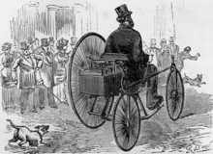
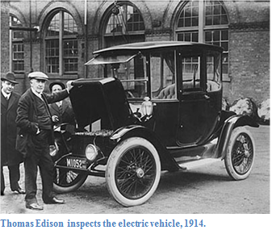
History of Electric Cars
The first practical electric cars were produced in the 1880s by Gustave Trouve.
In 1884, over 20 years before the Ford Model T, Thomas Parker built a practical production electric car in Wolverhampton using his own specially designed high-capacity rechargeable batteries
Electric cars were among the preferred for automobile in the late 19th and early 20th century
The electric vehicle stock peaked at approximately 30,000 vehicles at the turn of the 20th century.

Slide 5
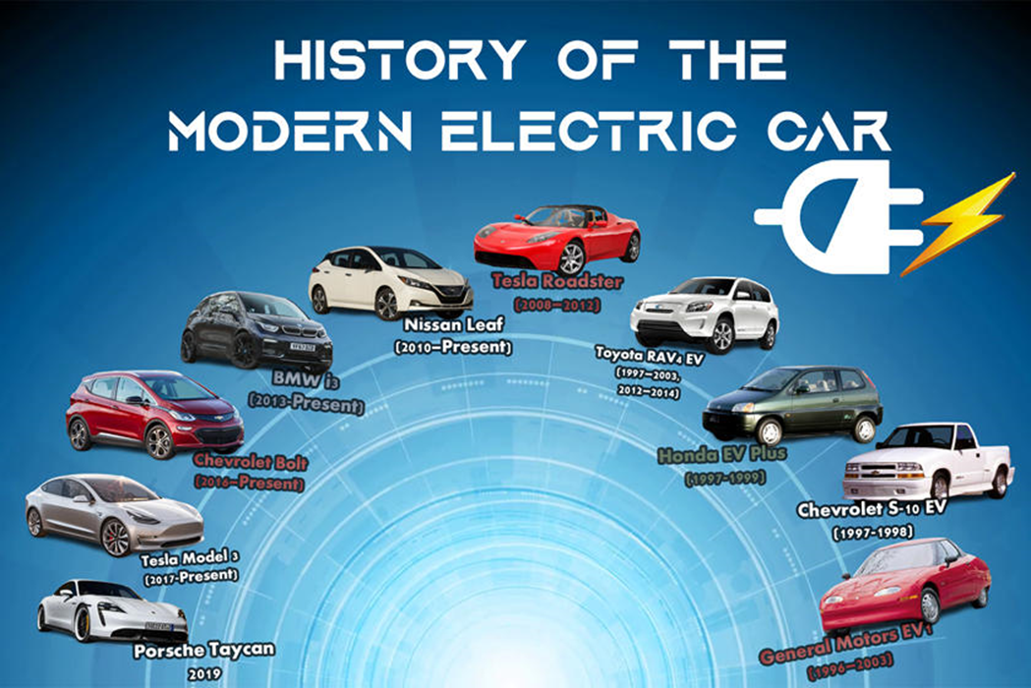
Electric Cars in Modern Era
Tesla currently dominating in this sector.
Tesla delivered 500,000 vehicles in 2020.
Electric cars hold One-fourth of market share which is increasing rapidly.
New emerging companies includes Envoy Technology, Hyliion, Ztractor etc.

Slide 6
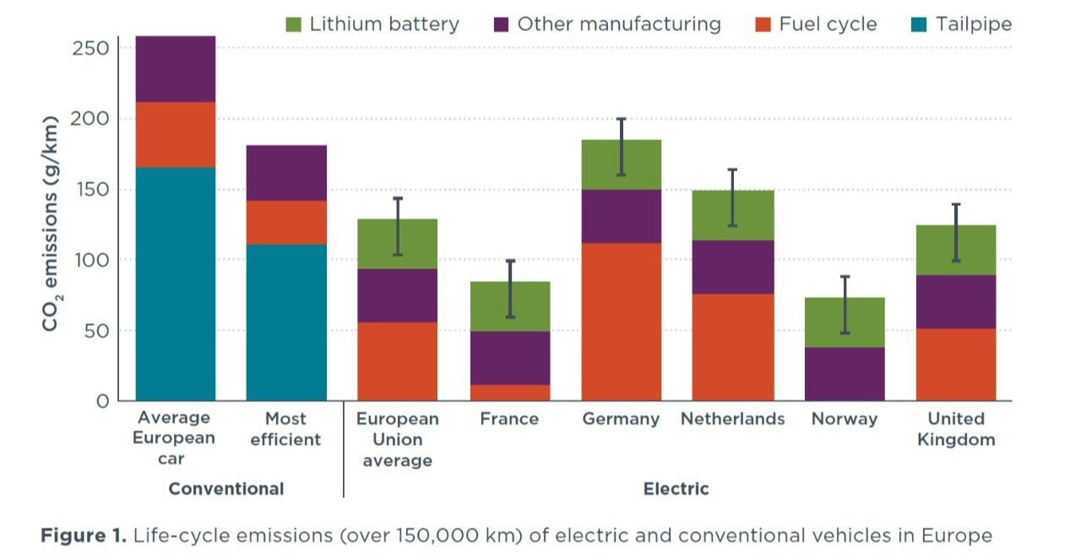
Are electric cars better for the environment?
Improving the air quality because these electric vehicles have no tailpipe, thus reducing green house gas emissions, for example CO2.
Over a year, just one electric car on the roads can save an average 1.5 million grams of CO2.
Therefore, participate in global warming prevention.
Making cleaner streets and a better environment for pedestrians
and cyclists.
They help to reduce noise pollution because their engine is much
quieter than traditional cars, so a very peaceful environment is maintained.

Slide 7
Production of the batteries of EVs
A recent study by a group of German researchers at the Thinktank Economic Research Institute (ifo) abouts Evs.
The emissions associated with the manufacture of electric car batteries, which numerous studies generate very different quantities, also have great uncertainties.
Battery output emissions may have a major effect on the climatic benefits of electricity vehicles as prices decrease, and car producers start to provide larger batteries with longer driving distances.
Around half of the emissions from battery production come from the electricity used in manufacturing and assembling the batteries.
Producing batteries in regions with relatively low-carbon electricity or in factories powered by renewable energy, as will be the case for the batteries used in the best-selling Tesla Model 3, can substantially reduce battery emissions.

Slide 8
Electric Cars vs Fuel Cars
Better for the air we breath
Skip the Gas Station, Fill-up at home and work
Low Maintenance Requirements
High Performance Vehicles
Road Anxiety- A thing of Past

Slide 9
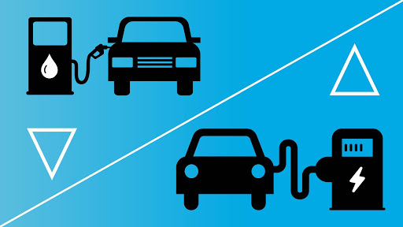
Electric Cars vs Fuel Cars(Stats Wise)
80% of energy is transferred directly to power the car.
Gasoline Vehicles costs $37 Billion in Health and Climate each year.
Switching to electric vehicle can reduce 50% carbon footprint.
Cost to power electric vehicle is half the cost per mile to power it by gasoline.
Electric Prices are much more stable than Gas prices.

Slide 10
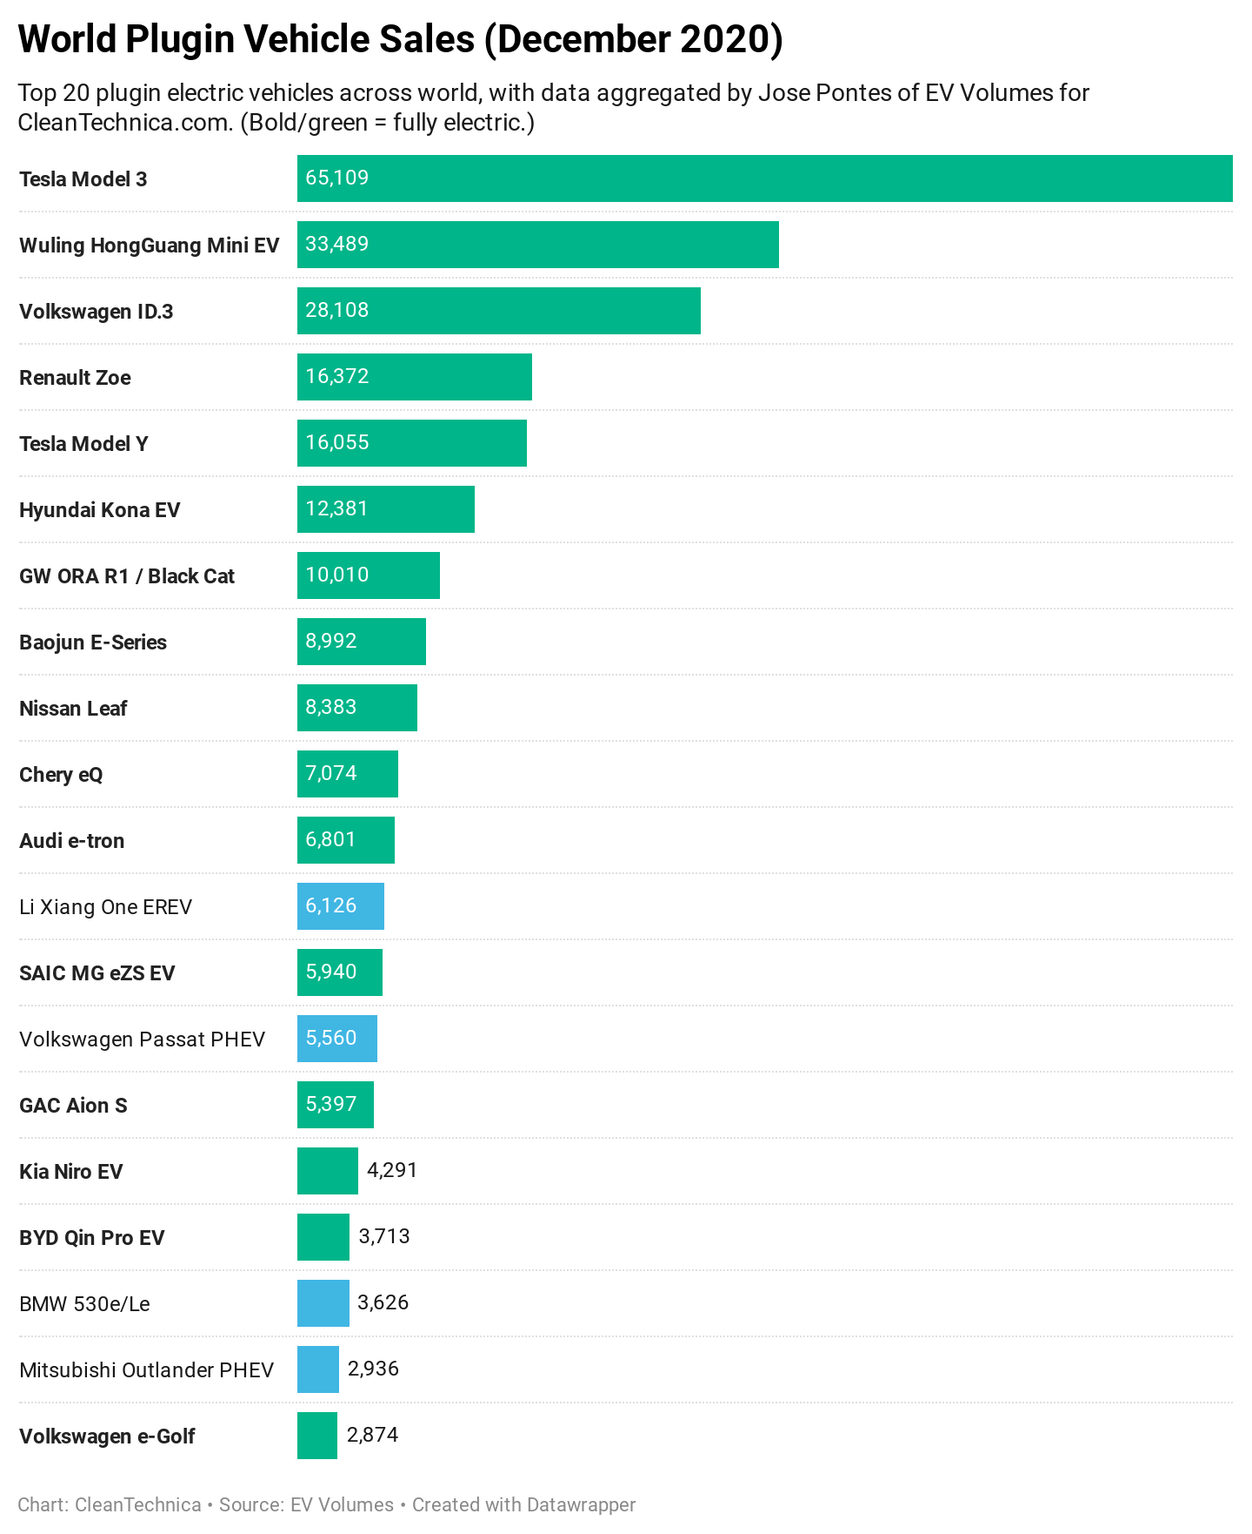
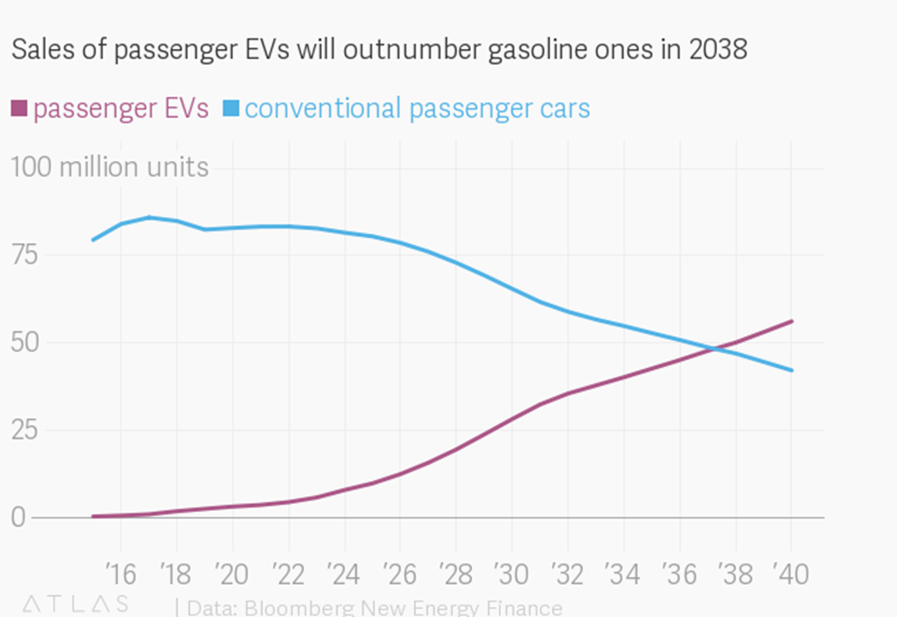
FACTS AND FIGURES

Slide 11
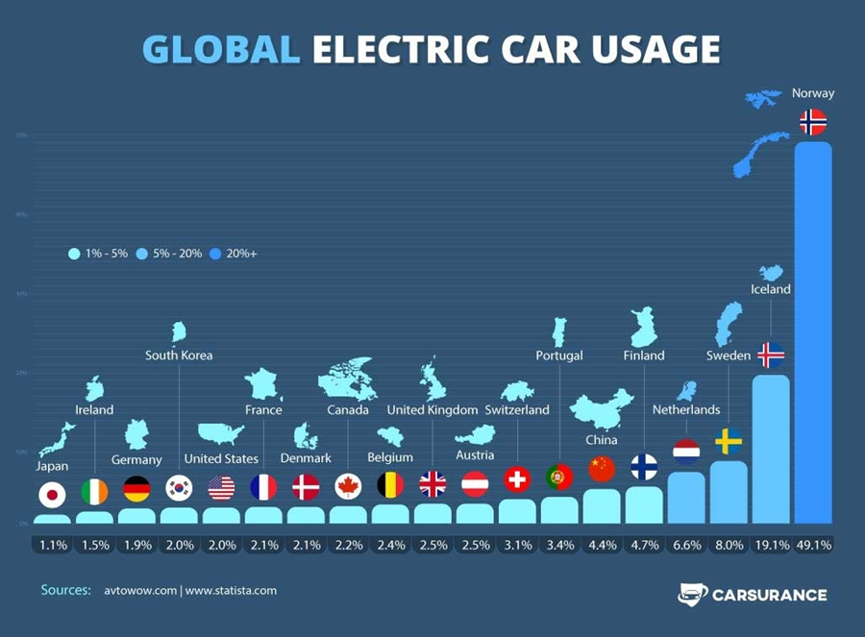
FACTS AND FIGURES

Slide 12

Conclusion
The future is all Electric.
A perfect substitution for Fuel Cars.
Better performance and stability.
User-friendly and easy to drive.

Slide 13
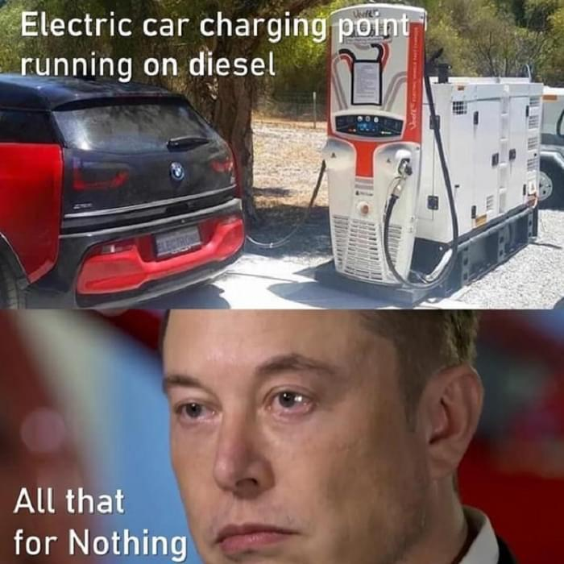
THANKYOU
You may ask your questions now
Team Members:
Ehtesham Zafar Jan
Hassan Ali
Raza Abidi
Furqan Fazal
Aliyan

